Slide 1

SMART INDIA HACKATHON 2026
Problem Statement ID – SIH26052
Problem Statement Title – To develop an AI/ML-enabled adaptive noise cancellation (ANC) system that effectively suppresses stationary, non-stationary, and impulsive defence noises while maintaining high speech intelligibility and real-time performance on embedded hardware.
Theme – Miscellaneous
PS Category – Hardware
Team ID –
Team Name – Scout Regiment

Slide 2

TinyML-Controlled Real-Time Adaptive Noise Cancellation
REAL-TIME SIGNAL CHAIN — 16 kHz · DUAL-CHANNEL I2S + DMA · CORE 0
Primary / Talk Mic
STAGE 0
STAGE 1
STAGE 2
OUTPUT
d(n) = s(n) + v(n) · speech + noise
Transient / Impulse
Detection & Protection
VSS-NLMS
Adaptive Filter
Wiener Spectral
Post-Filter
Enhanced
Speech
Reference Mic
Kurtosis-based fast transient clamp. Detects impacts and slams.
Variable step-size NLMS cancels noise correlated with the reference.
Suppresses residual, uncorrelated and non-stationary noise.
e(n) ≈ s(n) · I2S TX → MAX98357A
x(n) ≈ v(n) · ambient noise reference
sets μ / freezes adaptation
sets attenuation
TINYML CONTROL ENGINE · ASYNCHRONOUS, CORE 1 · CONTROL UPDATE EVERY 100 ms
500 ms context → 13–20 MFCC / log-mel → 3-class CNN (INT8) + VAD → step-size μ, post-filter attenuation, adaptation freeze
Real-time DSP
TinyML control
Speech protection
Sample- and block-level audio processing using transient protection, VSS-NLMS and Wiener filtering.
Classifies the acoustic condition as stationary noise, non-stationary noise or speech.
VAD and confidence-aware control reduce the risk of cancelling desired speech.
HOW IT ADDRESSES THE PROBLEM Each noise type named in the problem statement is handled by the mechanism suited to its timescale.
Stationary noise
Non-stationary noise
Impulsive noise
Speech intelligibility
Real-time embedded performance
Handled by adaptive NLMS convergence.
Variable step-size, ML-guided tuning and spectral cleanup.
Dedicated fast transient clamp — impulses are too fast for ML classification windows.
The TinyML engine freezes filter adaptation whenever speech is detected.
Lightweight classical DSP plus a small quantized controller model, not a heavy neural denoiser.
KEY INNOVATION TinyML does not replace the ANC algorithm — it intelligently controls the DSP parameters according to the detected acoustic condition.

Slide 3
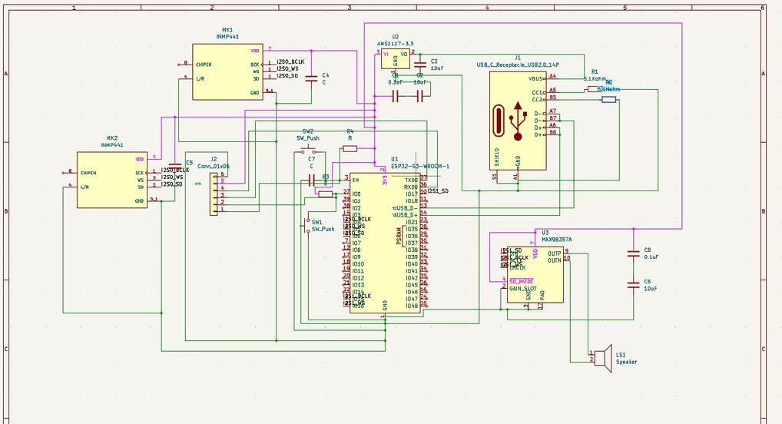
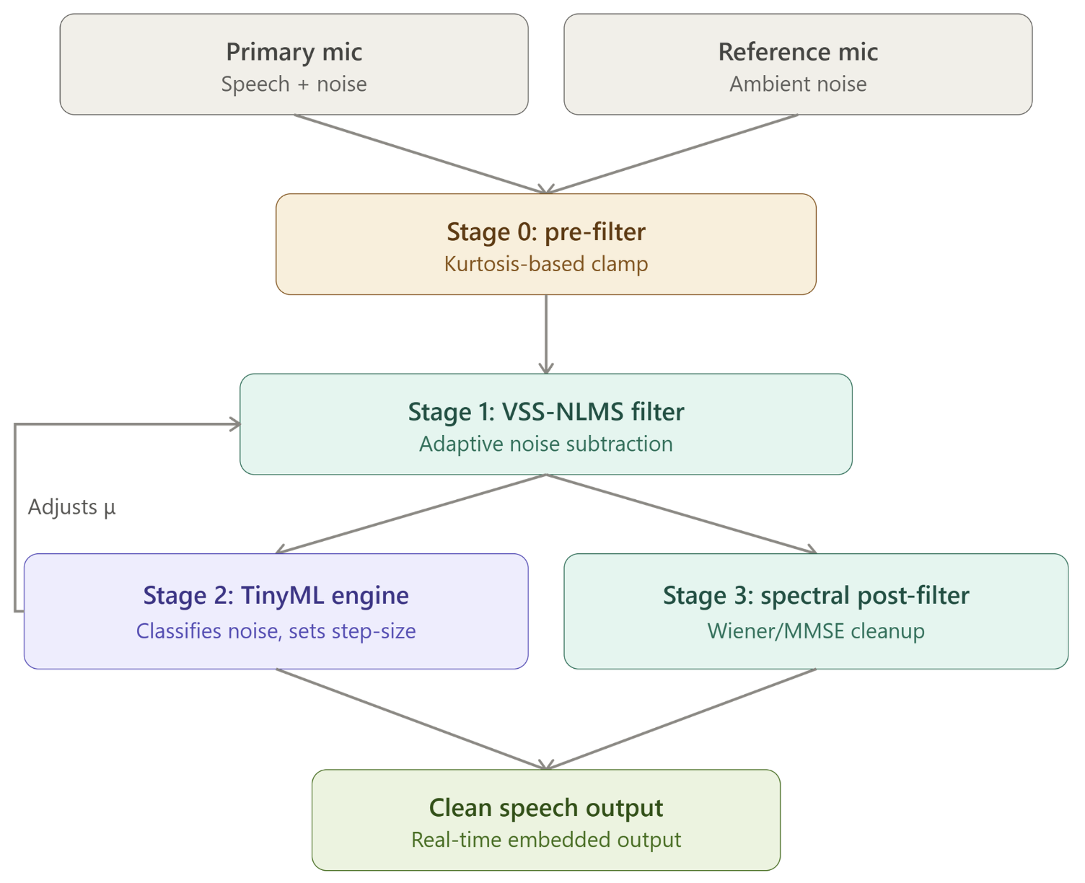
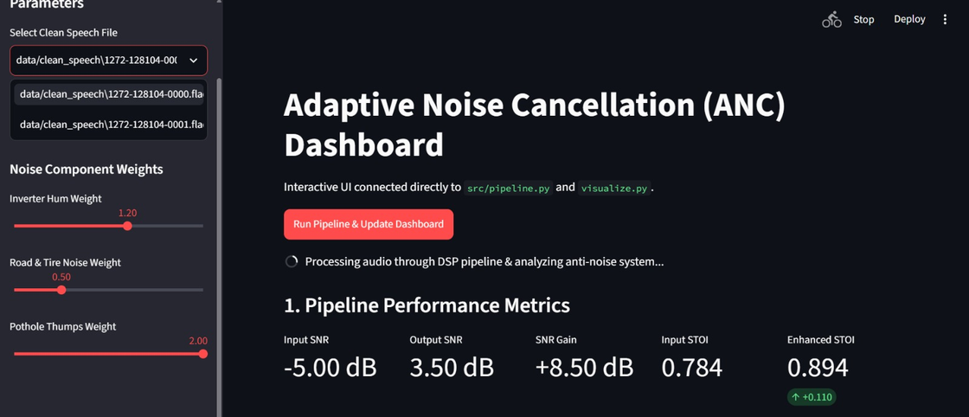
TECHNICAL APPROACH
V1 SCHEMATIC — KiCad
SOFTWARE, DSP & ML STACK
Python · NumPy · SciPy
librosa · SoundFile · PyRoomAcoustics
Matplotlib · pystoi (STOI scoring)
TensorFlow → INT8 post-training quantization
TFLite for Microcontrollers (planned deploy)
Streamlit dashboard · Tkinter hardware UI
C / C++ · ESP-IDF build tools
Data: LibriSpeech dev-clean @ 16 kHz
Stationary (DEMAND): NOFFICE/NFIELD/NPARK
Non-stationary: PCAFE/PSTATION/SSTRAFFIC
HARDWARE BOM — V1 / KiCad
INTERACTIVE ANC DASHBOARD — src/pipeline.py + visualize.py
ESP32-S3-WROOM-1 (dual-core, 240 MHz)
INMP441 I2S MEMS microphone × 2
MAX98357A I2S DAC + Class-D amp (5 V rail)
4–8 Ω speaker (V1 demonstration)
USB_C_Receptacle_USB2.0_14P (CC1/CC2 → 5.1 kΩ)
AMS1117-3.3 LDO — buck regulator for final build
Conn_01x06 header + external CP2102/FTDI
SSD1306 128×64 OLED telemetry (optional)
Push buttons, resistors, decoupling capacitors
REAL-TIME PROCESSING PIPELINE — ESP32-S3, DUAL-CORE

Slide 4
FEASIBILITY AND VIABILITY
WHY OUR DESIGN IS FEASIBLE
DUAL-MIC INPUT
ADAPTIVE DSP
TINYML CONTROL
EMBEDDED READY
Primary + Reference
VSS-NLMS + Wiener
3-class CNN → μ
ESP32-S3 dual-core
Feedforward noise estimation from an ambient reference channel. V2 adds an internal error mic for FxNLMS.
Tracks changing acoustic paths without manual retuning; post-filter clears residual noise.
INT8 quantized, target < 64 KB peak RAM and < 20 ms inference per 100 ms hop.
DSP on Core 0, TinyML on Core 1, DMA audio streaming — no Linux SBC required.
KEY RISKS AND MITIGATIONS
PROTOTYPE POWER BUDGET — V1
CHALLENGE
RISK
MITIGATION
ESP32-S3 (3.3 V, ~400 mA)
1.32 W
Speech leakage into reference mic
Speech may be cancelled as noise
VAD-gated adaptation and a lower NLMS step size
2 × INMP441 MEMS mics
0.013 W
SSD1306 OLED
0.066 W
Door slams or pothole impacts
Adaptive filter may become unstable
Kurtosis transient detection; temporary update freeze
MAX98357A + speaker (typical)
1.11 W
Changing noise conditions
Fixed filter parameters perform poorly
TinyML-based dynamic parameter selection
Estimated total
~2.5 W
Design margin ×1.5
~3.75 W
DSP and ML competing for CPU
Audio dropouts or added latency
DSP and TinyML pinned to separate ESP32-S3 cores
Recommended supply: 5 V / 2–3 A USB-C
FALLBACK POLICY When TinyML confidence falls below 0.60, the controller ignores the new prediction and retains the previous stable DSP state — the ANC path never depends on an uncertain classification.

Slide 5
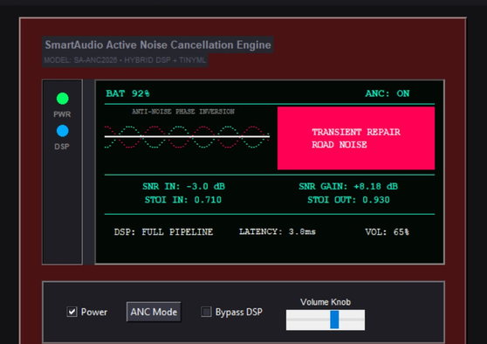
IMPACT AND BENEFITS
0.9298
HARDWARE UI SIMULATOR
Speech intelligibility (STOI) — Software PoC
STOI after processing
at -3 dB input SNR
+7.95 dB
Maximum reported
SNR gain
+0.2211
Maximum reported
STOI improvement
SPEECH INTELLIGIBILITY
REAL-TIME OPERATION
APPLICATIONS
Preserves speech while suppressing environmental noise.
Low-latency embedded processing; DSP and ML on separate cores.
EV cabin communication
Headsets & hearing protection
Voice-command systems
Industrial / vehicle comms
ADAPTIVE BEHAVIOUR
LOW-COST DEPLOYMENT
The classifier can be retrained with representative defence-noise recordings without changing the core DSP-control architecture.
Lower-power embedded processing reduces dependence on large computing platforms and supports portable, battery-powered systems.
DSP parameters follow the detected acoustic condition automatically.
An ESP32-S3 replaces a larger Linux-based computing platform.

Slide 6
RESEARCH AND REFERENCES
Datasets
J. Thiemann, N. Ito, and E. Vincent, "The Diverse Environments Multi-channel Acoustic Noise Database (DEMAND): A database of multichannel environmental noise recordings," Proc. Meetings on Acoustics, vol. 19, no. 1, 035081, 2013. — (your stationary + non-stationary noise source)
V. Panayotov, G. Chen, D. Povey, and S. Khudanpur, "Librispeech: An ASR corpus based on public domain audio books," 2015 IEEE ICASSP, pp. 5206–5210, 2015. — (your speech class)
Simulation environment
R. Scheibler, E. Bezzam, and I. Dokmanić, "Pyroomacoustics: A Python package for audio room simulation and array processing algorithms," 2018 IEEE ICASSP, pp. 351–355, 2018. — (your acoustic room simulation)
Core algorithms
Y. Ephraim and D. Malah, "Speech enhancement using a minimum mean-square error short-time spectral amplitude estimator," IEEE Trans. Acoustics, Speech, and Signal Processing, vol. 32, no. 6, pp. 1109–1121, 1984. — (theoretical basis for your Stage 3 Wiener/MMSE spectral post-filter)
S. Haykin, Adaptive Filter Theory, 5th ed., Prentice Hall, 2013. — (standard textbook reference for NLMS/VSS-NLMS, if your report cites a general adaptive-filtering source)
TinyML precedent
J.-M. Valin, "A hybrid DSP/deep learning approach to real-time full-band speech enhancement," 2018 IEEE 20th Int. Workshop on Multimedia Signal Processing (MMSP), pp. 1–5, 2018. — (RNNoise; the closest published precedent to your "small NN + classical DSP" philosophy — strong to cite for the judges)
TOOLING & LIBRARIES NumPy · SciPy · librosa · SoundFile · Matplotlib · pystoi (STOI scoring) · PyRoomAcoustics · TensorFlow with INT8 post-training quantization · TensorFlow Lite for Microcontrollers (planned deployment) · ESP-IDF

